Slide 1
Program Design
Object-Oriented Analysis (Overview)
An investigation of the problem (rather than how a solution is defined)
During OO analysis, there is an emphasis on finding and describing the objects (or concepts) in the problem domain.
For example, concepts in a Library Information System include Book, and Library.
High level views found in the application domain.
Oftentimes called domain objects; entities.

Slide 2
Design (The ‘hows.’ The Solution Space.)
Deciding how the requirements should be implemented, using the available technology
Includes:
Systems engineering: Deciding what should be in hardware and what in software (not in this course)
Software architecture: Dividing the system into subsystems and deciding how the subsystems will interact: Architecture is the key part of design – addresses questions on HOW the system will be built.
Detailed design of the internals of a subsystem
User interface design
Database design
Functional design

Slide 3
Object-Oriented Design
Emphasizes a conceptual solution that fulfills the requirements.
Need to define software objects and how they collaborate to meet the requirements.
For example, in the Library Information System, a Book software object may have a title attribute and a getChapter method.
What are the methods needed to process the attributes?
Designs are implemented in a programming language.
In the example, we will have a Book class in Java.

Slide 4
Write the code for the following program
A program is required to process student exam results.
Each Student sits in 3 exams. The first exam is weighted as 50% of the marks for the year, the second and third exams each count for 25% of the marks. The program should report the overall mark awarded to each student, highest, lowest and average class marks.

Slide 5
Example: A program is required to process student exam results.
Each Student sits in 3 exams. The first exam is weighted as 50%
of the marks for the year, the second and third exams each count
for 25% of the marks. The program should report the overall mark
awarded to each student, highest, lowest and average class marks.
Top Level
Initialize counters
Enter ExamMark1 for the first student
WHILE ExamMark1 <> 999 DO
Enter Rest of marks
Calculate overall mark
Display OverallMark for student
Update totals (i.e highest, lowest, counts for average)
Enter ExamMark1 for next student
END WHILE
Calculate Average
Display Totals
END

Slide 6
Bottom Up Design
Step#1
Step#3 Methods
void calculateOverAllMarks(…..){…..}
void updateTotal_HCM_LCM(….){….}
void calculateAverage(……){…..}
void displayTotals(…){…..}
class StudentExamResults{
//Student objStud1, objStud2, objStud3;
double dOAM;
double iHCM, iLCM, dAvgMarks, iTM;
final int iMarkSentinel = -999;
int iEM1, iEM2, iEM3;
:
:
}
Step#2 Add a Constructor
StudentExamResults() {
dTM=0.0;
dHM=-1.0;
dLM=-100.0;
}

Slide 7
?? calculateOverAllMarks(…..){
dOAM = iEM1 * 0.5 + iEM2 *.25 + iEM3 *.25;
}
?? updateTotal_HCM_LCM(….){
dTM = dTM + dOAM;
if(dOAM > dHM)
dHM = dOAM;
else if(dOAM < dLM)
dLM = dOAM;
}
?? calculateAverage(???){
dAM = dTM / iStudentCnt;
}

Slide 8
Visually Model Software
A Model is a simplification of reality that produces a complete description of something
from a specific perspective.
We build models when we cannot fully comprehend the complexity of some things.
Modeling helps the development team visualize, specify, construct, and document the
structure and behavior of a system’s architecture.
We will use a standard modeling language, UML (Unified Modeling Language).

Slide 9
The UML is a tool for specifying software systems. Standardized diagram types to help you describe and visually map a software system's design and structure. Using UML it is possible to model just about any kind of application, both specifically and independently of a target platform. While UML is naturally oriented towards Object-Oriented programming, but it is just as easy to model procedural languages such as C, Visual Basic, Fortran etc.

Slide 10
What is the purpose of Use Case Diagram?
The purpose of a use case diagram in UML is to demonstrate the different ways that a user might interact with a system.

Slide 11
Use case diagram components
Actors: The users that interact with a system. An actor can be a person, an organization, or an outside system that interacts with your application or system. They must be external objects that produce or consume data.
System/Scenario: a specific sequence of actions and interactions between actors and the system, a.k.a. a use case instance
• System boundary boxes: A box that sets a system scope to use cases. All use cases outside the box would be considered outside the scope of that system.

Slide 12
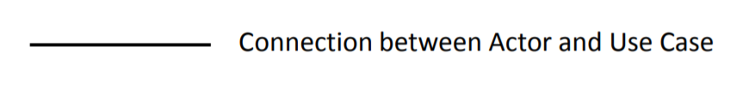
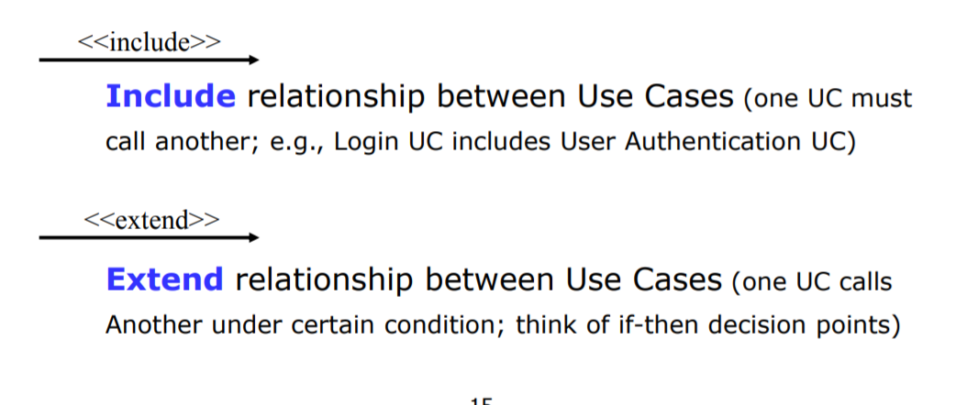
Use cases: Horizontally shaped ovals that represent the different uses that a user might have.
Relationships:
Association:

Slide 13
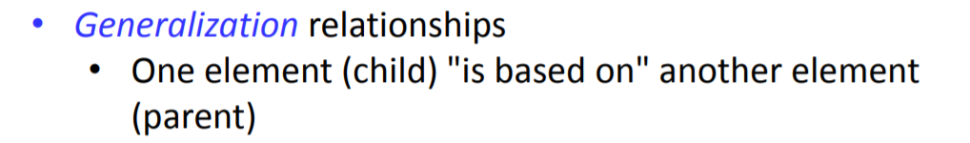

Slide 14
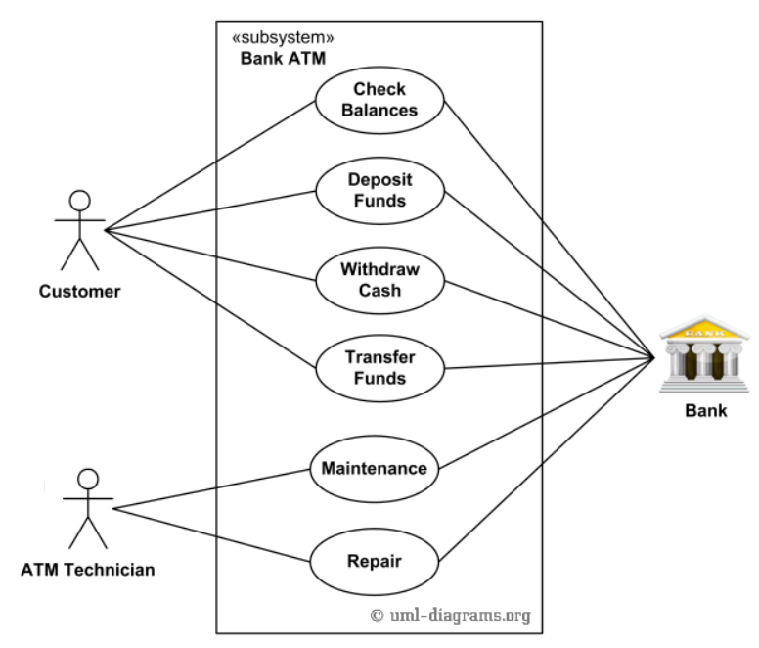
UML Use Case Diagrams: Examples
https://www.uml-diagrams.org/use-case-diagrams-examples.html
Purpose: Describe use cases that an automated teller machine (ATM) or the automatic banking machine (ABM) provides to the bank customers.
Summary: Customer uses a bank ATM to check balances of his/her bank accounts, deposit funds, withdraw cash and/or transfer funds (use cases). ATM Technician provides maintenance and repairs to the ATM.

Slide 15
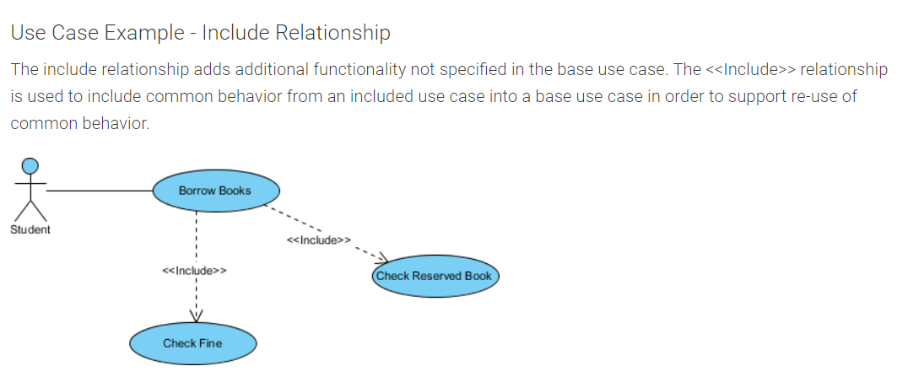

Slide 16
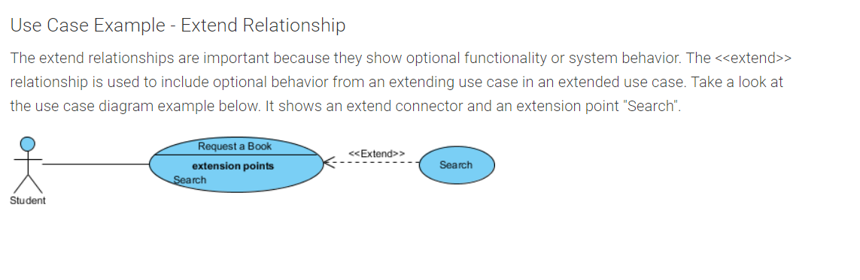

Slide 17
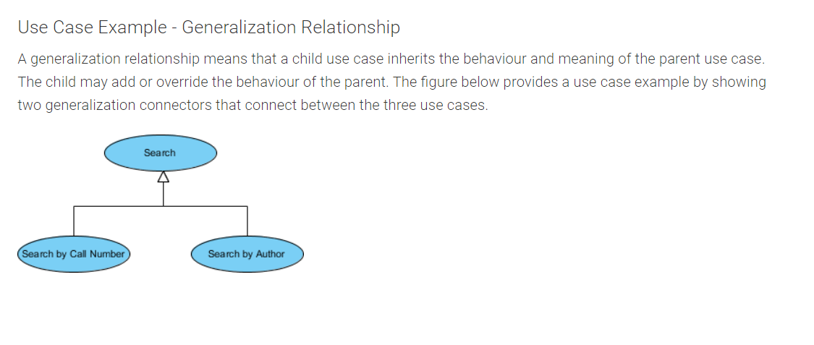

Slide 18
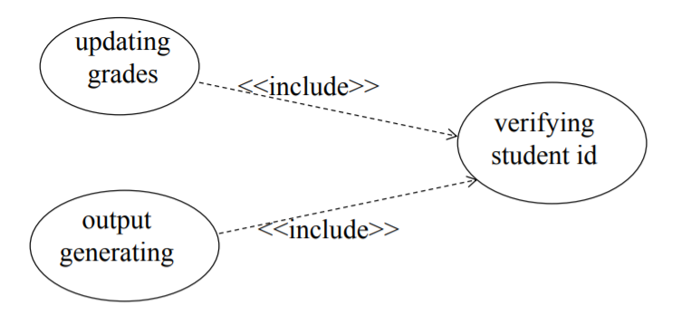

Slide 19
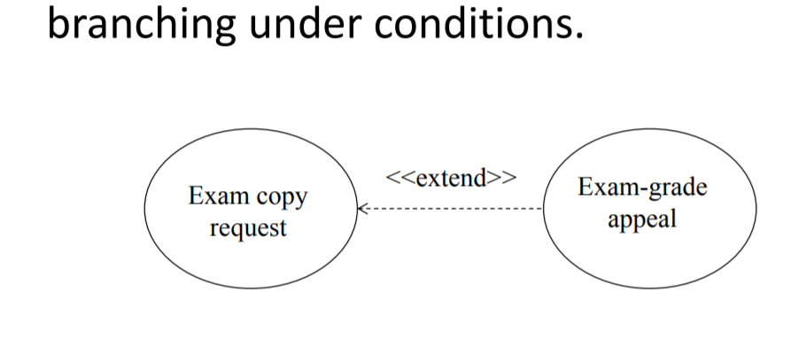

Slide 20
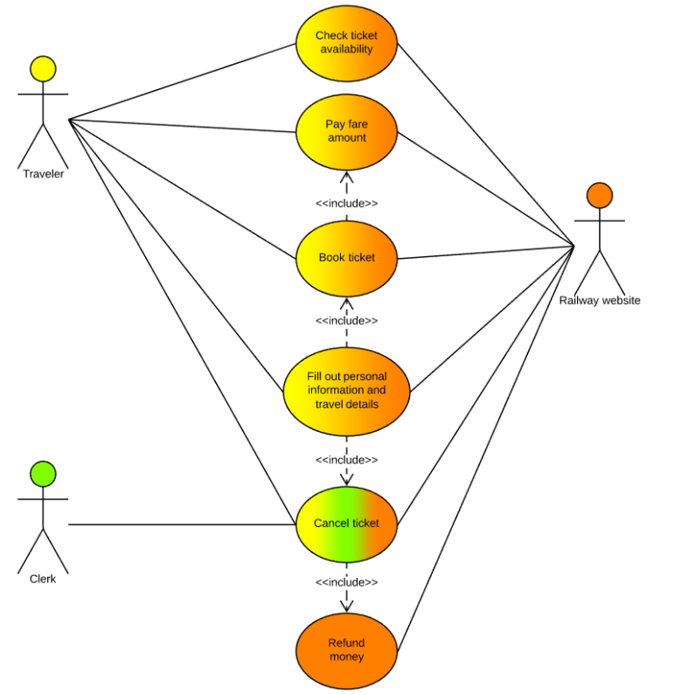

Slide 21
Create a one dimensional array and initialize it with squares from 1-10.
Create a 2-dimensional array of 10 rows, each row contains the value (from 1-10) and its square.
3. Create a Vehicle class having fields: type(like bus, car, pickup), passengerCapacity, maintainanceCharges. Create an array of 10 vehicles and find the vehicle having maximum maintainanceCharges.

